Slide 1
WELCOME TO MY PRESENTATION Presentation topic General purpose registers and its special functions.
Name: Sagor ray
Id: 20191135010
Sec: D

Slide 2
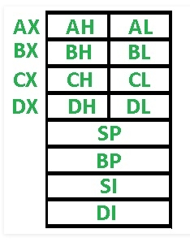
general purpose register in 8086
The general purpose registers are used to store temporary data in the time of different operations in microprocessor. The registers inside the 8086 are all 16 bits 8086 has eight general purpose registers. These are available to the programmer, for storing values during programs. Each of these can be divided into two 8-bit registers such as AH, AL; BH, BL; CL, CH and DL, DH.

Slide 3
general purpose register in 8085
The 8085 has six general-purpose registers to store 8-bit data;
These are identified as- B, C, D, E, H, and L.
These can be combined as register pairs – BC, DE, and HL, to perform some 16-bit operation.
These registers are used to store or copy temporary data, by using instructions, during the execution of the program

Slide 4
general purpose registers functions in 8086
Register | Function
AX | This is the accumulator. It is 16-bit registers, but it is divided into two 8-bit registers. These registers are AH and AL. AX generally used for arithmetic or logical instructions, but it is not mandatory in 8086.
BX | BX is another register pair consisting of BH and BL. This register is used to store the offset values.
CX | CX is generally used as control register. It has two parts CH and CL. For different looping and counting purposes these are used.

Slide 5
general purpose registers functions in 8086
Register | Function
DX | DX is data register. The two parts are DH and DL. This register can be used in Multiplication, Input/output addressing etc.
SP | This is the stack pointer. The stack pointer points the top most element of the stack. For empty stack SP will be at position FFFEH.
BP | BP is another 16-bit register. This is base pointer register. This register is primary used in accessing the parameters passed by the stack. It’s offset address relatives to stack segment.

Slide 6
general purpose registers functions in 8086
Register | Function
SI | This is Source Index register. This is used to point the source in some string related operations. Its offset is relative to data segment.
DI | This is destination index register. This is used to point destination in some string related operations. Its offset is relative to extra segment.

Slide 7
The end
Thank You

